Slide 1
DESIGN A PROTOTYPE OF SLAM ROBOT USING LIDAR SENSOR
Mentor- Dr. M.K.Meshram, Dept of Electronics Engg
Team Members – Pranava, Soujanya, Akshay, Jayantha

Slide 2
What is SLAM?
SLAM is the process by which a robot builds a map of the environment and, at the same time, uses this map to compute its location
Localization: inferring location given a map
Mapping: inferring a map given a location
Simultaneous Localization and mapping (SLAM)- learning a map and locating the robot simultaneously

Slide 3
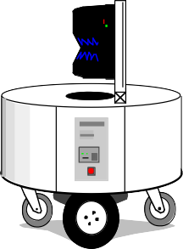
Why Simultaneous?
SLAM is a chicken-or-egg problem:
→ A map is needed for localizing a robot
→ A pose estimate is needed to build a map
Thus, SLAM is (regarded as) a hard problem in robotics

Slide 4



The Basic Problem
GIVEN
The robot’s controls
Observations
WANTED
Map of the environment
Path of the robot

Slide 5
The Problem: SLAM
SLAM with Known Map (Localization)
GIVEN
The robot’s controls
Observations
WANTED
Map of the environment
Path of the robot
Restriction: Known data association (for now)

Slide 6
The Problem: SLAM
SLAM with Known Locations (Mapping)
SLAM with Known Map (Localization)
Restriction: Known data association (for now)

Slide 7
The Problem: SLAM
SLAM with Known Locations (Mapping)
S L A M
Limit
Restriction: Known data association (for now)

Slide 8
Why is SLAM a hard problem?
SLAM: robot path and map are both unknown
The problem can be solved because map and pose estimates are correlated
Robot path error correlates errors in the map

Slide 9
Why is SLAM a hard problem?
Robot pose
uncertainty
In the real world, the mapping between observations and landmarks is unknown
Picking wrong data associations can have catastrophic consequences
Pose error correlates data associations

Slide 10
Applications of SLAM
SLAM is central to a range of indoor, outdoor, in air and underwater applications for both manned and autonomous vehicles.
Examples:
At home: vacuum cleaner, lawn mower
Air: surveillance with unmanned air vehicles
Underwater: reef monitoring
Underground: exploration of mines
Space: terrain mapping for localization

Slide 11
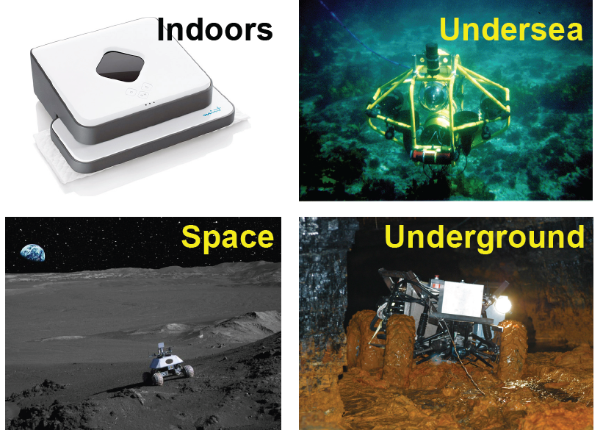
Applications of SLAM

Slide 12
Aim of the project
We aim to apply SLAM in indoor environments.
It would be helpful to navigate autonomously and tackle obstacles.
Applications-
Autonomous wheelchairs - beginning step for VOCOWA- VOice COntrolled Wheelchair Autonomous.

Slide 13
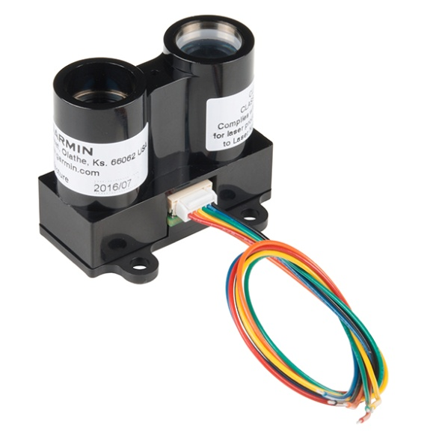
Work Done so far
Hardware used-
LIDAR Sensor
Purpose - For distance measurement
Input – I2C signal from arduino
Output – Time elapsed

Slide 14
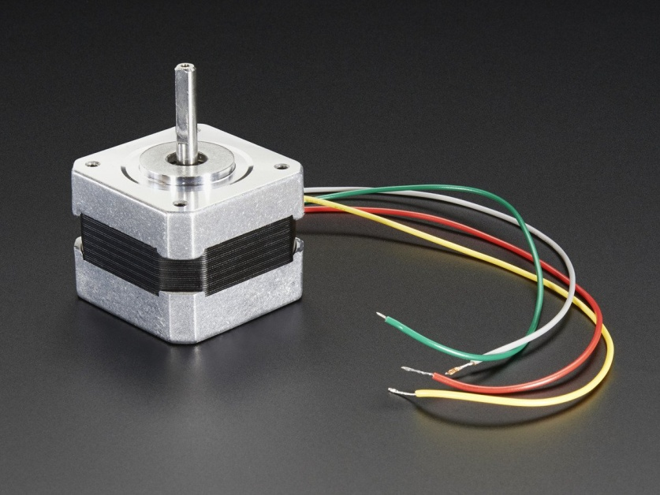
2. Stepper Motor
Purpose- For rotating the LIDAR
Input-
Output-
Mode of Operation-

Slide 15
Integration
The LIDAR sensor was attached to the shaft of the stepper motor so as to rotate it and get a complete 360 degree view of the environment.
200 steps-----?????

Slide 16
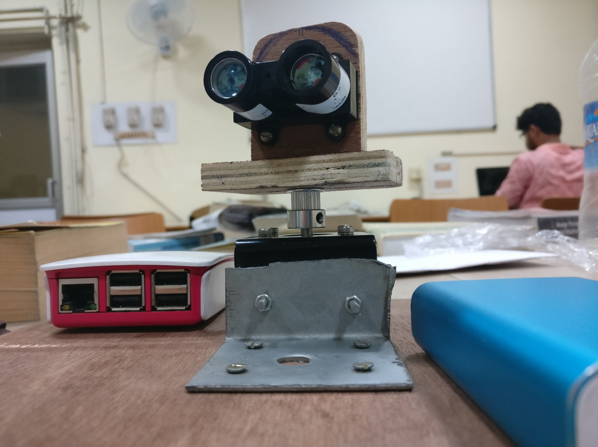

Slide 17
Progress so far
We have implemented SLAM with a known location of the robot.
Results- demo envo + map generated

Slide 18
The Three SLAM paradigms
Most of the SLAM algorithms are based on the following three different approaches:
Extended Kalman Filter SLAM: (called EKF SLAM)
Particle Filter SLAM: (called FAST SLAM)
Graph-Based SLAM

Slide 19
Two main SLAM Algorithms
Extended Kalman Filter (EKF) SLAM
Solves online SLAM problem
Uses a linearized Gaussian probability distribution model
FastSLAM
Solves full SLAM problem
Uses a sampled particle filter distribution model

Slide 20
Extended Kalman Filter SLAM
An EKF (Extended Kalman Filter) is the heart of the SLAM process.
It is responsible for updating where the robot thinks it is based on the Landmarks (features).
The EKF keeps track of an estimate of the uncertainty in the robots position and also the uncertainty in these landmarks it has seen in the environment.

Slide 21
Overview
Laser Scans
Odometry Change
Landmark Extraction
EKF Odometry update
Data Association
EKF Re-observation
EKF New
Observations

Slide 22
Fast SLAM - Particle Filters
Solves the Full SLAM problem using a particle filter
Particle Filters- Represent probability distribution as a set of discrete particles which occupy the state space

Slide 23
Summary
We have implemented SLAM with a known location of the robot.
We plan to further implement SLAM in an unknown environment in order to achieve autonomous navigation.

